Slide 1
CH2PH2:
Chemical Kinetics
Dr. James Hallett
j.e.hallett@reading.ac.uk

Slide 2
CH2PH/OR/IN2:
Chemical Kinetics
Dr. James Hallett
j.e.hallett@reading.ac.uk

Slide 3
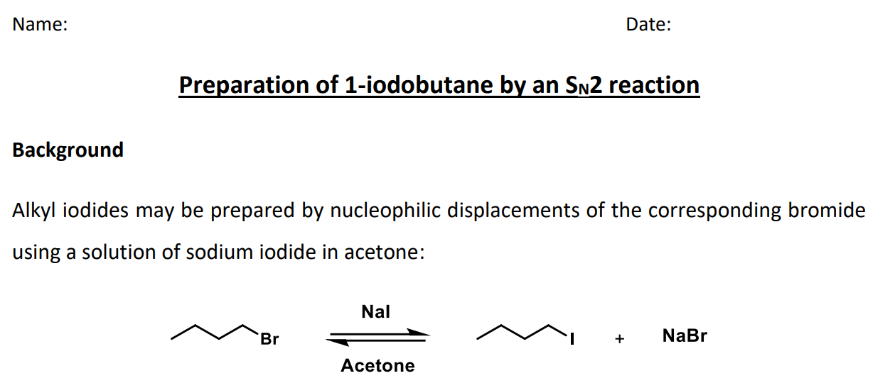
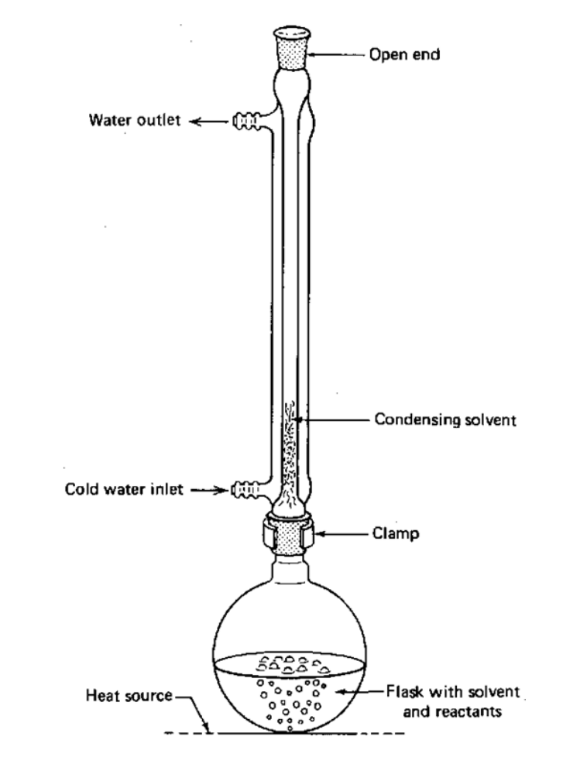
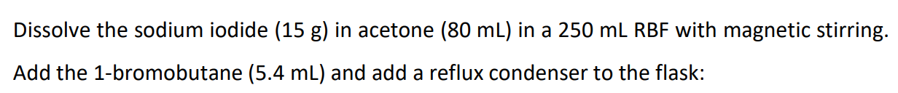
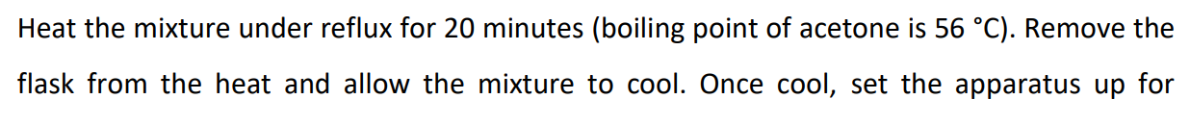
Kinetics in organic chemistry
Good yield = optimise reaction to increase the rate of the thing you want, decrease the rates of byproducts

Slide 4
  If we understand the kinetics of a chemical reaction, we understand:
    How quickly we convert from reactants to products
    How the rate of reaction changes when we change the reaction conditions
    What reaction pathways can or will occur

Slide 5
  If we understand the kinetics of a chemical reaction, we understand:
    How long to run the experiment
    How much stuff to use
    How to get more of the stuff we want and less of the stuff we don’t
Understand the kinetics
Do more effective reactions

Slide 6
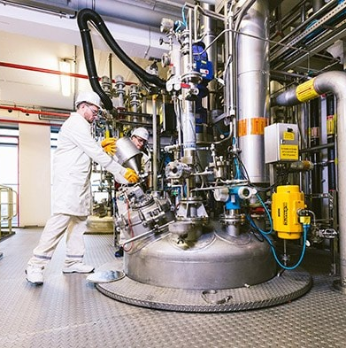
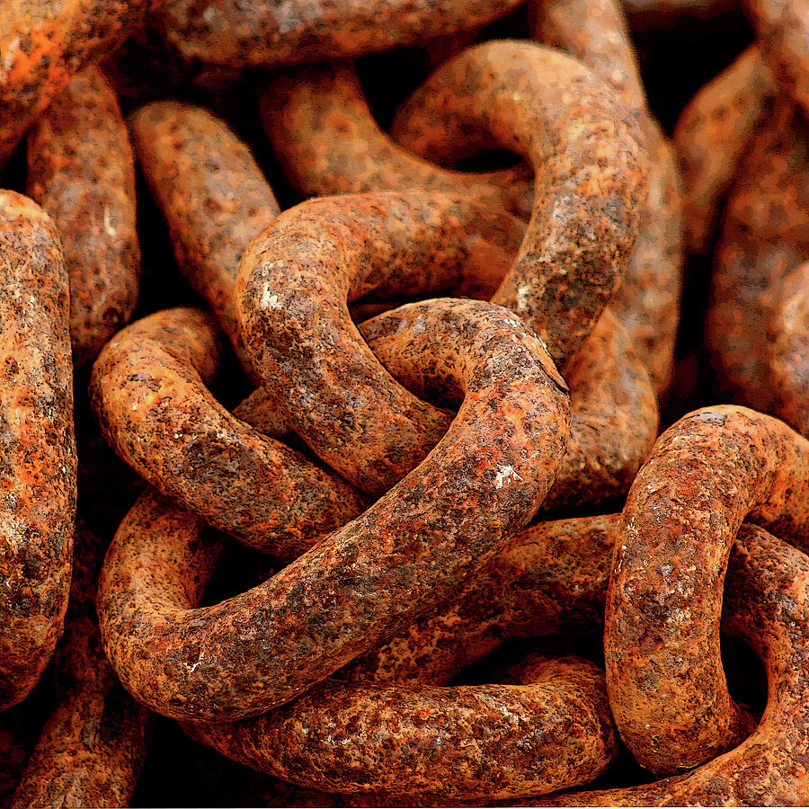
How can we change the kinetics of a reaction?
  Concentration
  Temperature
  Humidity
  Pressure
  Acidity
  Presence of a catalyst
Sigma Aldrich, pixels

Slide 7
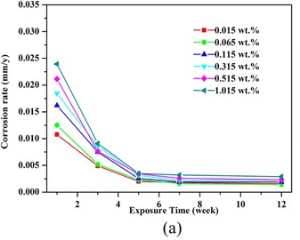
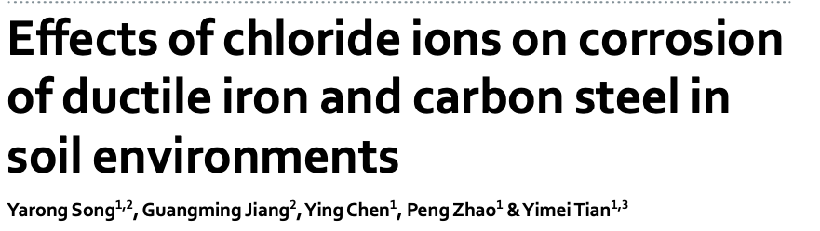
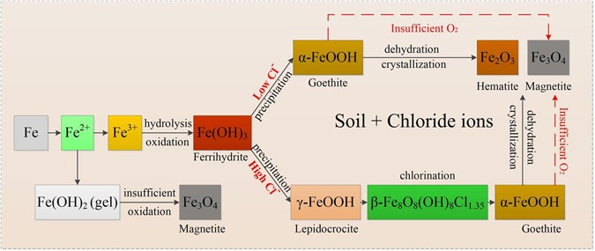
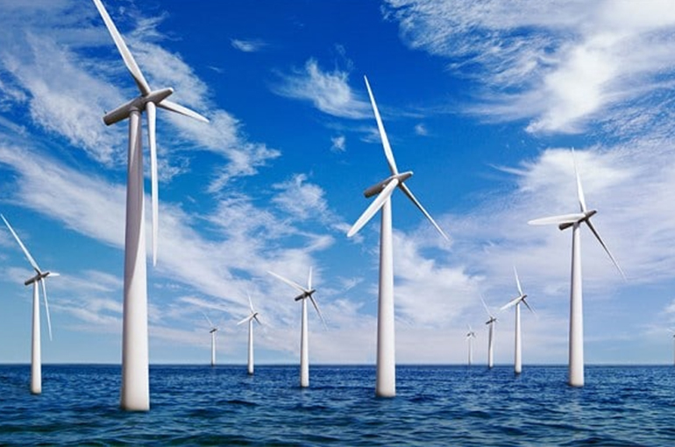
Song, Y., Jiang, G., Chen, Y., Zhao, P., & Tian, Y. (2017). Scientific reports, 7(1), 1-13.
Notes:
7% of all steel production each year is to replace corroded components

Slide 8
Outline
Revision: 1-step reactions;
  first order, second order etc; rate equation; unimolecular, bimolecular etc
Two-step reactions; multi-step reactions; steady state
Chain reactions; branching chain reactions; explosions
Experimental techniques
  Flow methods; Flash photolysis; Lasers

Slide 9
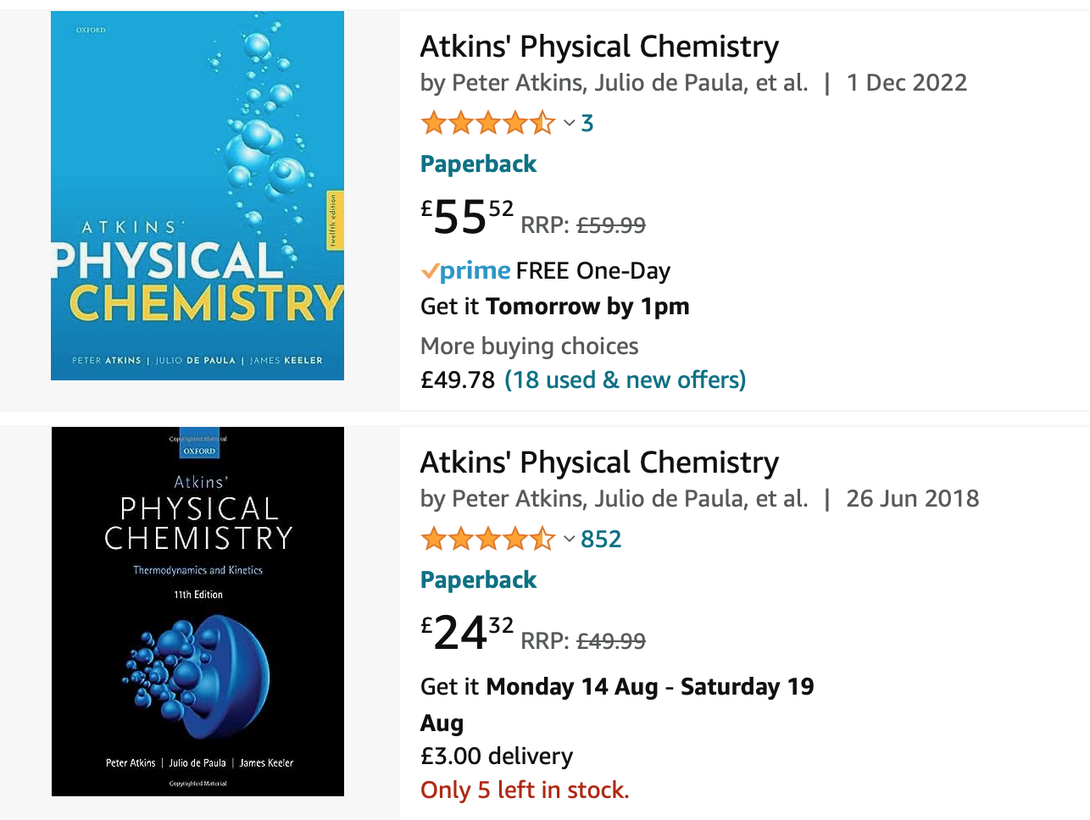
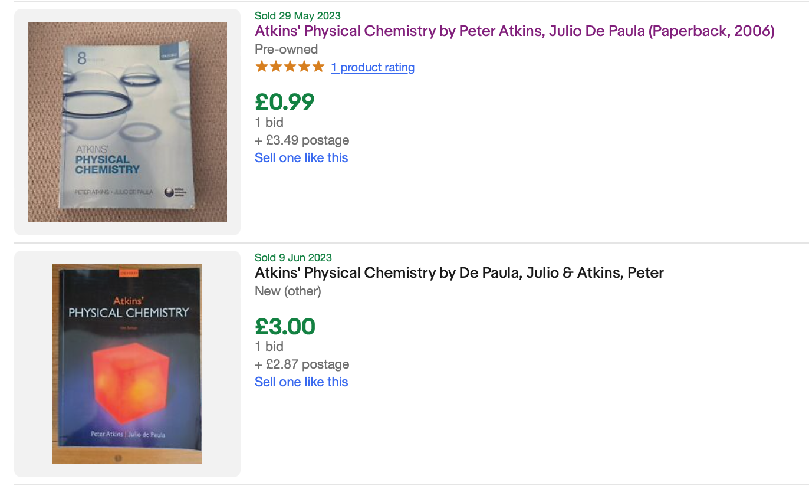
Books
  As always, Atkins Physical Chemistry (12th edition)
  Get it out of the library, read it online (via the library), read it in G50.

Slide 10
revision from part 1

Slide 11
Remember: The Rate Equation
[Reactants]
Stoichiometry
[Products]
Rate
Rate equation
  In this course we will learn:
  How to determine the rate equation experimentally
  How to predict the rate equation from a mechanism

Slide 12

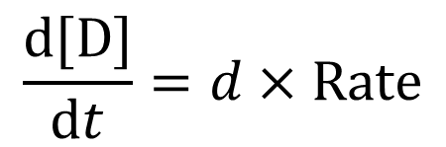
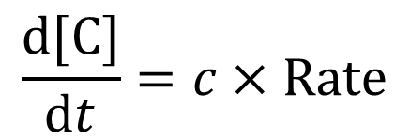
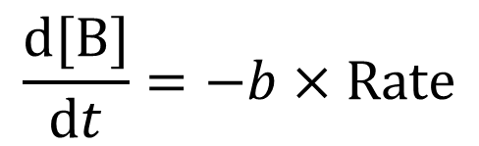
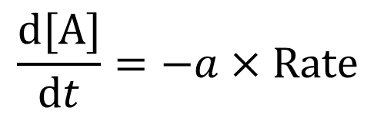
The “Rate” of a chemical reaction
We can find the rate of change of every reactant or product from the rate ($v$)
$$a\text{A}+b\text{B} \underset{→}{ } c\text{C}+d\text{D}$$
$$\frac{\text{d}[\text{A}]}{\text{d}t}=−a×\text{Rate}$$
$$\frac{\text{d}[\text{B}]}{\text{d}t}=−b×\text{Rate}$$
$$\frac{\text{d}[\text{C}]}{\text{d}t}=c×\text{Rate}$$
$$\frac{\text{d}[\text{D}]}{\text{d}t}=d×\text{Rate}$$

Slide 13
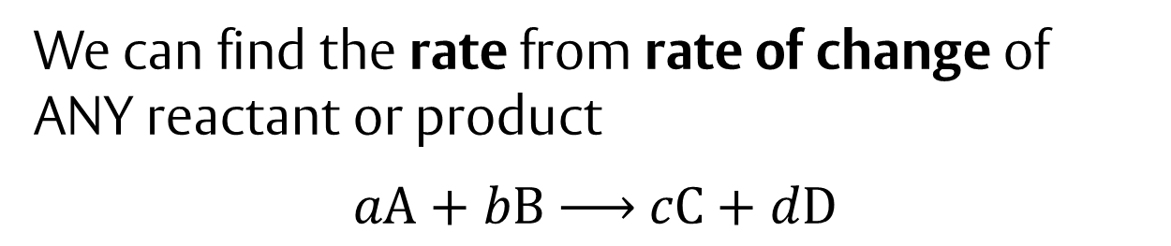
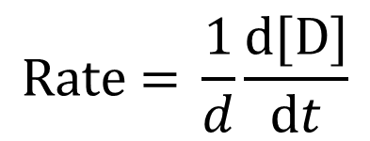
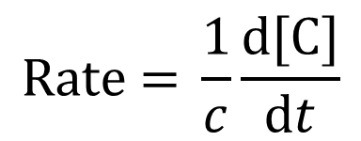
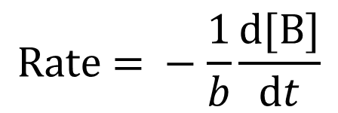
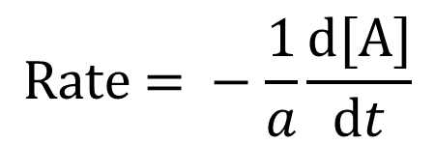
We can find the rate from rate of change of ANY reactant or product
$$a\text{A}+b\text{B} \underset{→}{ } c\text{C}+d\text{D}$$
$$\text{Rate}\text{ = }−\frac{1}{a}\frac{\text{d}[\text{A}]}{\text{d}t}$$
$$\text{Rate}\text{ = }−\frac{1}{b}\frac{\text{d}[\text{B}]}{\text{d}t}$$
$$\text{Rate}\text{ = }\frac{1}{c}\frac{\text{d}[\text{C}]}{\text{d}t}$$
$$\text{Rate}\text{ = }\frac{1}{d}\frac{\text{d}[\text{D}]}{\text{d}t}$$

Slide 14
Task
Consider the following reaction:
Br₂(aq) + HCOOH(aq) → 2H⁺(aq) + 2Br⁻ (aq)+ CO₂(g)
At a given stage in the reaction, the rate of change in bromide concentration is
d[Br⁻]/dt = 1 M s⁻¹
Write down:
(i) Rate
(ii) d[CO₂ ]/dt
(iii) d[H⁺ ]/dt
(iv) d[Br₂ ]/dt

Slide 15
Task: Answer
Consider the following reaction:
Br₂(aq) + HCOOH(aq) → 2H⁺(aq) + 2Br⁻ (aq)+ CO₂(g)
At a given stage in the reaction, the rate of change in bromide concentration is
d[Br⁻]/dt = 1 M s⁻¹
Write down:
(i) Rate = 0.5 M s⁻¹
(ii) d[CO₂ ]/dt = 0.5 M s⁻¹
(iii) d[H⁺ ]/dt = 1 M s⁻¹
(iv) d[Br₂ ]/dt = −0.5 M s⁻¹

Slide 16
Remember: Rate Law
The Rate Law is an expression that relates reactant concentration to reaction rate
For example: A + B → products
Rate law: Rate α [A]^{n}[B]^{m} Rate = k[A]^{n}[B]^{m}
  k = rate constant (independent of [ ])
  n = order with respect to [A]
  m = order with respect to [B]
  n + m = overall order of the reaction
n and m can NOT be deduced from the overall balanced chemical reaction equation
The Rate Law must by determined by experiment, or predicted from a mechanism (we will learn how to do this!)

Slide 17
Remember: Rate Law
Rate here means “rate of change of concentration as a function of time” – so always has units of concentration/time (e.g. M s⁻¹, moles dm⁻³s⁻¹)
Rate constants allow us to balance units to achieve this.
Rate = k[A][B]
c t⁻¹=k c c
M s⁻¹=k M M
Units of k: M⁻¹ s⁻¹

Slide 18
Worked example
A + 2B →C + 3D
Experiments show this to be second order with respect to A, and zeroth order with respect to B, with rate constant k₂
Calculate:
Rate
Rate of change of [D]
Rate of change of [B]
Rate of change of [A]

Slide 19
Worked example: Answer
A + 2B →C + 3D
Experiments show this to be second order with respect to A, and zeroth order with respect to B, with rate constant k₂
Calculate:
Rate Rate = k₂[A]² = d[C]/dt
Rate of change of [D] d[D]/dt = 3 × Rate = 3 k₂[A]²
Rate of change of [B] d[B]/dt = −2 × Rate = −2 k₂[A]²
Rate of change of [A] d[A]/dt = −Rate = −k₂[A]²

Slide 20
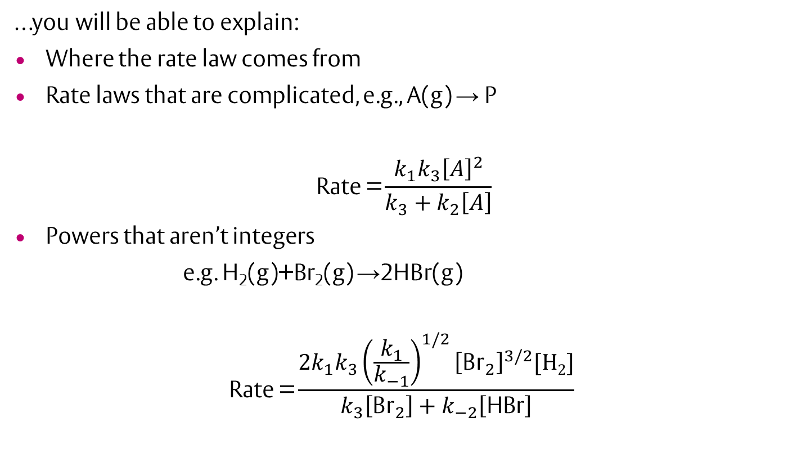
By the end of this lecture course…
…you will be able to explain:
Where the rate law comes from
Rate laws that are complicated, e.g., A(g) → P
$$\text{Rate}\text{ =}\frac{k_{1}k_{3}{\left[A\right]}^{2}}{k_{3}+k_{2}\left[A\right]}$$
Powers that aren’t integers
e.g. H₂(g)+Br₂(g) →2HBr(g)
$$\text{Rate}\text{ =}\frac{2k_{1}k_{3}{\left(\frac{k_{1}}{k_{−1}}\right)}^{1/2}{\left[{\text{Br}}_{2}\right]}^{3/2}[H2]}{k_{3}\left[{\text{Br}}_{2}\right]+k_{−2}\left[\text{HBr}\right]}$$

Slide 21
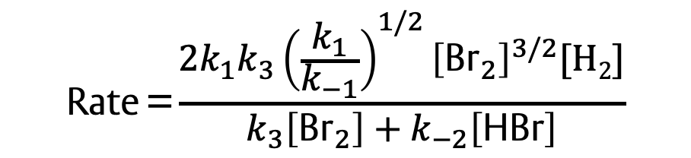


Rate constant units
Rate normally expressed as concentration/ time, e.g. mM/s, nM/nanosecond…
Rate = k [A] =(???)(concentration)
To compare two rate constants, they must have the same units
$$\text{Rate}\text{ =}k_{1}\left[A\right]$$
$$\text{Rate}\text{ =}\frac{k_{1}k_{3}{\left[A\right]}^{2}}{k_{3}+k_{2}\left[A\right]}$$
$$\text{Rate}\text{ =}\frac{2k_{1}k_{3}{\left(\frac{k_{1}}{k_{−1}}\right)}^{1/2}{\left[{\text{Br}}_{2}\right]}^{3/2}[H2]}{k_{3}\left[{\text{Br}}_{2}\right]+k_{−2}\left[\text{HBr}\right]}$$

Slide 22
Multistep reactions

Slide 23
Most real reactions are multi-step reactions
This example contains two steps. Each single step has a simple rate law.
How do we calculate “Rate” (of formation of Products) for the overall reaction?
We want a rate law only involving measurable reactant (and product) concentrations – no intermediates.
k₁
k₂
A → I → Products
Energy
Products
I
A
Reaction Coordinate

Slide 24
Rules for determining rate equation for multi-step reactions (1)
Suggested reaction is a series of one-step reactions.
Each single step, an “elementary reaction”, follows simple kinetics.
For each elementary reaction, we can write the rate equation just from the chemical equation.
The order of the reaction is the same as the molecularity…

Slide 25
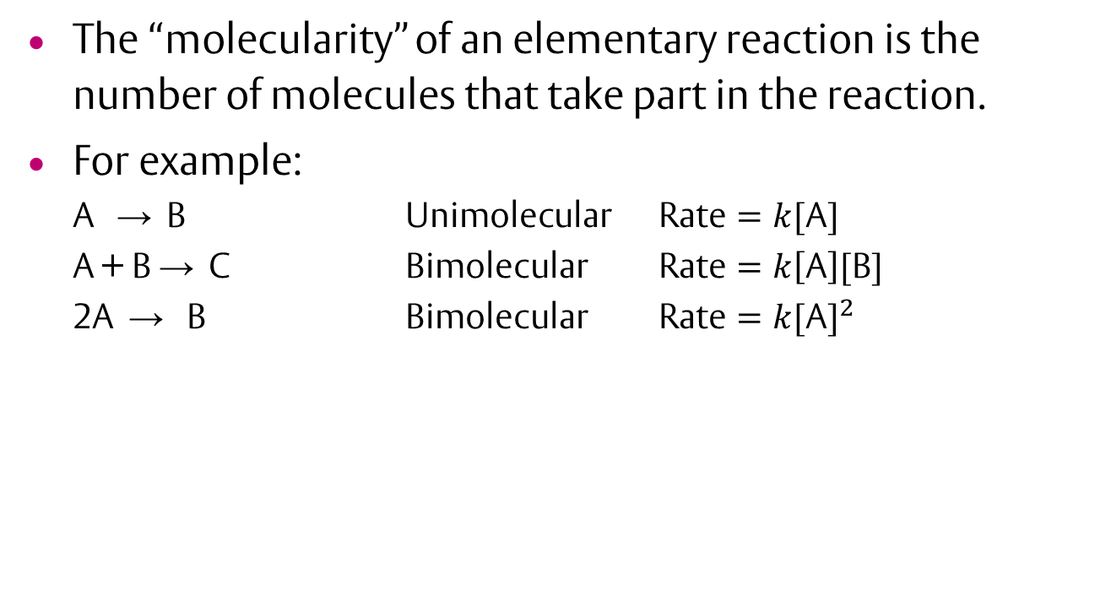
Order and molecularity
The “molecularity” of an elementary reaction is the number of molecules that take part in the reaction.
For example:
  A → B Unimolecular $\text{Rate}=k[\text{A}]$
  A + B → C Bimolecular $\text{Rate}=k\left[\text{A}\right][\text{B}]$
  2A → B Bimolecular $\text{Rate}=k{[\text{A}]}^{2}$

Slide 26
Rules for determining rate equation for multi-step reactions (2)
Many components will have elementary reactions that make them, and other elementary reactions that remove them.
Calculate the (overall) rate of change of each component:
  For each elementary reaction, add the rate if it makes that component. Subtract the rate if it removes that component.
  Don’t forget to multiply by the number of molecules of that component that the elementary reaction makes or removes.

Slide 27



Example
$$A\underset{→}{k_{1}}I\underset{→}{k_{2}}P$$
Two elementary steps
$$A\underset{→}{k_{1}}I$$
Unimolecular Rate₁ = k₁[A]
$$I\underset{→}{k_{2}}P$$
Unimolecular Rate₂ = k₂[I]
Rate of change of [A] = −Rate₁ = −k₁[A]
Rate of change of [P] = Rate₂ = k₂[I]
Rate of change of [I] = +Rate₁ −Rate₂ =k₁[A]−k₂[I]

Slide 28



Example
$$A\underset{→}{k_{1}}I 2I\underset{→}{k_{2}}P$$
Two elementary steps
$$A\underset{→}{k_{1}}I$$
Unimolecular Rate₁ = k₁[A]
$$2I\underset{→}{k_{2}}P$$
Bimolecular Rate₂ = k₂[I]²
d[A]/dt = −Rate₁ = −k₁[A]
d[P]/dt = Rate₂ = k₂[I]²
d[I]/dt = Rate₁ – 2Rate₂ = k₁[A] − 2k₂[I]²

Slide 29



Worked Example
$$2A\underset{→}{k_{1}}I\underset{→}{k_{2}}2P$$
Two elementary steps
$$2A\underset{→}{k_{1}}I$$
$$I\underset{→}{k_{2}}2P$$
d[A]/dt =
d[P]/dt =
d[I]/dt =

Slide 30
Worked Example: Answer
$$2A\underset{→}{k_{1}}I\underset{→}{k_{2}}2P$$
Two elementary steps
$$2A\underset{→}{k_{1}}I$$
Bimolecular Rate₁ = k₁[A]²
$$I\underset{→}{k_{2}}2P$$
Unimolecular Rate₂ = k₂[I]
d[A]/dt =
d[P]/dt =
d[I]/dt =
− 2Rate₁
= − 2k₁[A]²
2Rate₂
= 2k₂[I]
+Rate₁ − Rate₂
= k₁[A]² − k₂[I]

Slide 31
Learning Outcomes
Today we have:
Revised part 1 kinetics
Used reactions to work out relative rates of change
Defined the difference between rate and rate constants
Distinguished between order and molecularity
Solved our first multi-step reactions

